Slide 1
Link State Routing
Prepared by
Divya K S
Adi Shankara Institute of Engineering & Technology
Kalady

Slide 2
Link State Routing
Distance vector routing was used in the ARPANET until 1979, when it was replaced by link state routing.
Two primary problems with distance vector routing is that
It did not take line bandwidth into account when choosing routes.
Count-to-infinity problem

Slide 3
Link State Routing-steps
Each router must do the following:
1. Discover its neighbors and learn their network addresses.
2. Measure the delay or cost to each of its neighbors.
3. Construct a packet telling all it has just learned.
4. Send this packet to all other routers.
5. Compute the shortest path to every other router.
The complete topology and all delays are experimentally measured and distributed to every router.
Then Dijkstra's algorithm can be run to find the shortest path to every other router.

Slide 4
Discover its neighbors and learn their network addresses
When a router is booted, its first task is to learn who its neighbors are.
It accomplishes this goal by sending a special HELLO packet on each point-to-point line.
The router on the other end is expected to send back a reply giving its name.
These names must be globally unique because when a distant router later hears that three routers are all connected to F, it is essential that it can determine whether all three mean the same F.

Slide 5
Measure the delay or cost to each of its neighbors.
This algorithm requires each router to know the estimate of delay to each of its neighbours.
The most direct way to determine this delay is to send over the line a special ECHO packet that the other side is required to send back immediately.
By measuring the round-trip time and dividing it by two, the sending router can get a reasonable estimate of the delay.

Slide 6
Construct a packet telling all it has just learned.
Once the information needed for the exchange has been collected, the next step is for each router to build a packet containing all the data.
The packet starts with the identity of the sender, followed by a sequence number and age (to be described later) and a list of neighbors.
The cost to each neighbor is also given
Building the link state packets is easy.
The hard part is determining when to build them.
One possibility is to build them periodically, that is, at regular intervals.
Another possibility is to build them when some significant event occurs, such as a line or neighbor going down or coming back up again or changing its properties appreciably.

Slide 7
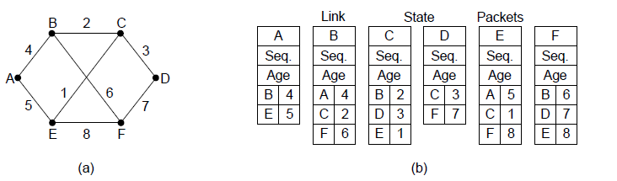
Construct a packet telling all it has just learned.
(a) A network. (b) The link state packets for this network.

Slide 8
Send this packet to all other routers
The next step is distributing the link state packets
The fundamental idea is to use flooding to distribute the link state packets to all routers.
To keep the flood in check, each packet contains a sequence number that is incremented for each new packet sent.
Routers keep track of all the (source router, sequence) pairs they see.
When a new link state packet comes in, it is checked against the list of packets already seen.
If it is new, it is forwarded on all lines except the one it arrived on.
If it is a duplicate, it is discarded.
If a packet with a sequence number lower than the highest one seen so far ever arrives, it is rejected as being obsolete as the router has more recent data

Slide 9
Problems with this algorithm
This algorithm has a few problems, but they are manageable.
First, if the sequence numbers wrap around, confusion will reign. (Using the sequence numbers again and again once all of them got used up, in order to maintain the continuity of data transfer ” is called Wrap around the concept)
The solution here is to use a 32-bit sequence number. With one link state packet per second, it would take 137 years to wrap around, so this possibility can be ignored.
Second, if a router ever crashes, it will lose track of its sequence number.
If it starts again at 0, the next packet it sends will be rejected as a duplicate.

Slide 10
Problems with this algorithm
Third, if a sequence number is ever corrupted and 65,540 is received instead of 4 (a 1-bit error), packets 5 through 65,540 will be rejected , since the current sequence number will be thought to be 65,540.
The solution to all these problems is to include the age of each packet after the sequence number and decrement it once per second.
When the age hits zero,the information from that router is discarded.

Slide 11
Computing the New Routes
Once a router has accumulated a full set of link state packets, it can construct the entire network graph because every link is represented.
Every link is, in fact, represented twice, once for each direction.
Now Dijkstra’s algorithm can be run locally to construct the shortest paths to all possible destinations.
The results of this algorithm tell the router which link to use to reach each destination.
This information is installed in the routing tables, and normal operation is resumed.

Slide 12
multicast routing
Some applications require that widely-separated processes work together in groups, for example, a group of processes implementing a distributed database system.
In these situations, it is frequently necessary for one process to send a message to all the other members of the group.
If the group is small, it can just send each other member a point-to point message.
If the group is large, this strategy is expensive.

Slide 13
multicast routing
Sometimes broadcasting can be used, but using broadcasting to inform 1000 machines on a million-node network is inefficient because most receivers are not interested in the message (or worse yet, they are definitely interested but are not supposed to see it).
Thus, we need a way to send messages to well-defined groups

Slide 14
multicast routing
Sending messages to well-defined groups is called multicasting, and the routing algorithm used is called multicast routing.
All multicasting schemes require some way to create and destroy groups and to identify which routers are members of a group.
Each group is identified by a multicast address and that routers know the groups to which they belong.

Slide 15
multicast routing
Multicasting requires group management. Some way is needed to create and destroy groups, and to allow processes to join and leave groups.
when a process joins a group, it informs its host of this fact.
It is important that routers know which of their hosts belong to which groups.
Either hosts must inform their routers about changes in group membership, or routers must query their hosts periodically.
Either way, routers learn about which of their hosts are in which groups.
Routers tell their neighbors, so the information propagates through the subnet.

Slide 16
multicast routing
To do multicast routing, each router computes a spanning tree covering all other routers.
For example, in Fig.(a) we have two groups, 1 and 2.
Some routers are attached to hosts that belong to one or both of these groups, as indicated in the figure.
A spanning tree for the leftmost router is shown in Fig. (b).
When a process sends a multicast packet to a group, the first router examines its spanning tree and prunes it, removing all lines that do not lead to hosts that are members of the group.
In our example, Fig.(c) shows the pruned spanning tree for group 1.
Similarly, Fig. (d) shows the pruned spanning tree for group 2.
Multicast packets are forwarded only along the appropriate spanning tree.

Slide 17
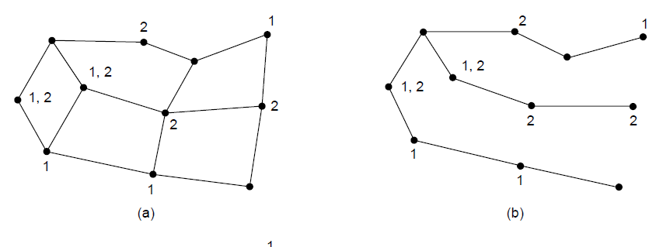
(a) A network. (b) A spanning tree for the leftmost router

Slide 18
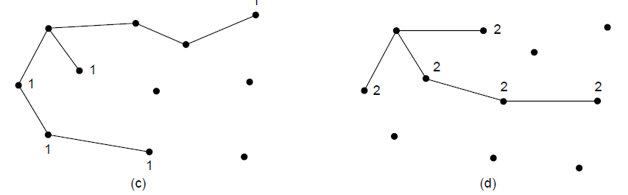
(c) A multicast tree for group 1. (d) A multicast tree for group 2.

Slide 19
Applications
Multimedia
Teleconferencing
Database
Distributed computations
Real time workshop
File ,graphics and messages are exchanged among active group members in real time

